Slide 1
SS ZG 526: Distributed Computing
Deadlocks in Distributed Systems
Chittaranjan Hota
Professor, Dept. of Computer Sc. & Information Systems
BITS, Pilani Hyderabad Campus, Hyderabad
hota@hyderabad.bits-pilani.ac.in

Slide 2
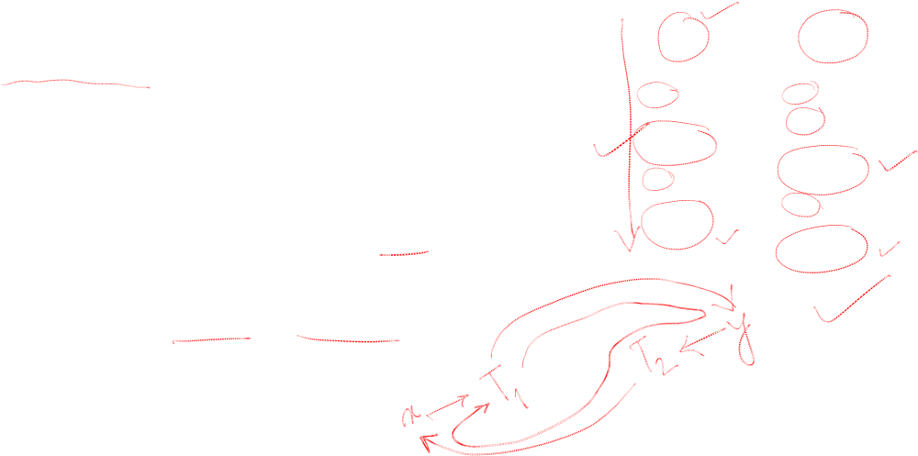
What is a deadlock?
One or more processes waiting indefinitely for resources to be released by other waiting processes.
Can occur on h/w or s/w resources, but mostly seen on distributed databases (Lock & Unlock).
T₁
T₂
…
lock(x)
…
lock(y)
…
….
lock(y)
…
lock(x)
time
Birla Institute of Technology and Science, Pilani (Deemed University)

Slide 3
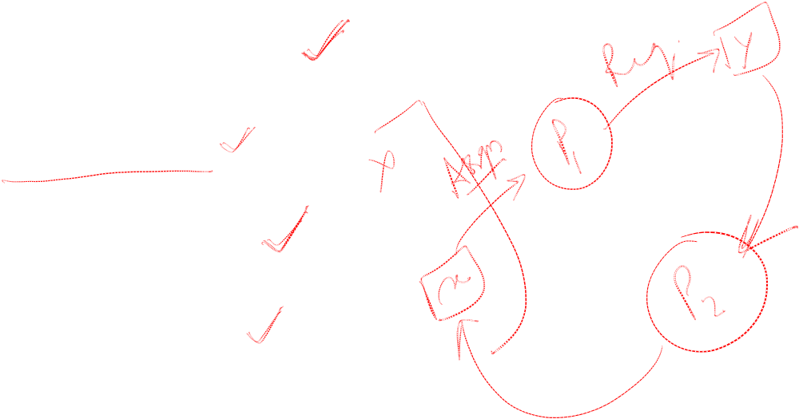
Conditions for deadlock
Mutual Exclusion
Hold & Wait
No Preemption
Circular Wait.
Birla Institute of Technology and Science, Pilani (Deemed University)

Slide 4
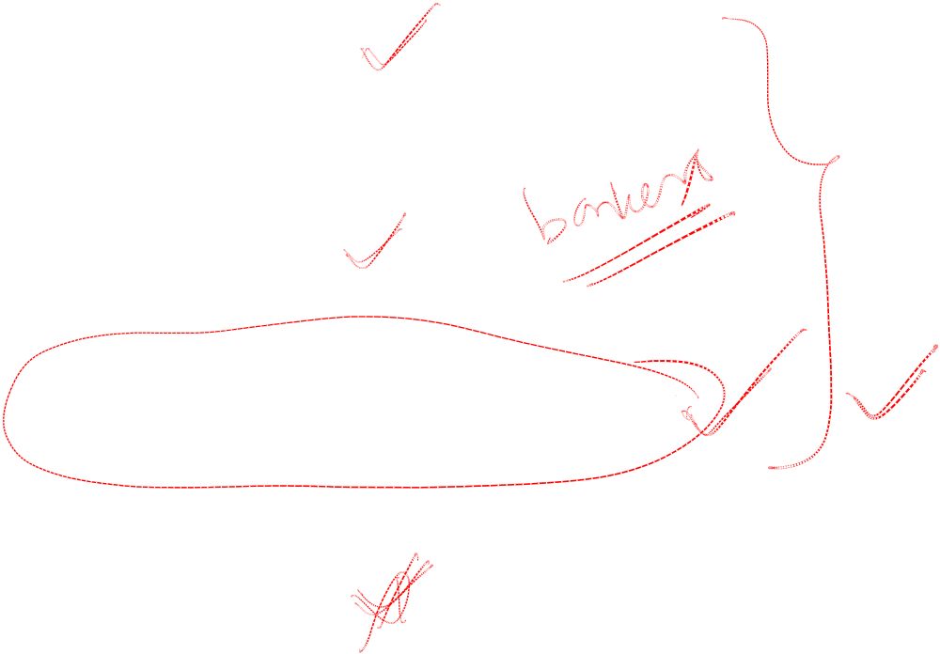
Ways to handle deadlocks
Prevention
Avoidance
Detection and resolution
Ignorance
Birla Institute of Technology and Science, Pilani (Deemed University)

Slide 5
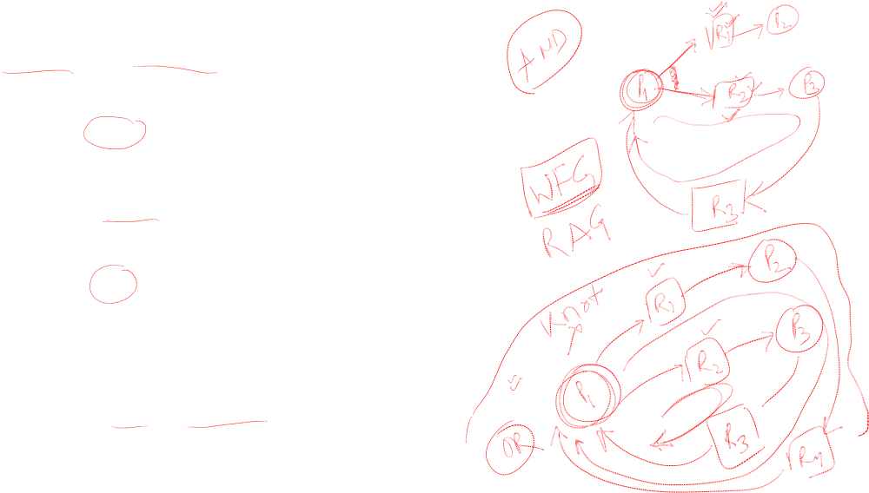
Cycle Vs Knot
The AND model of requests requires all resources currently being requested to be granted to un-block a computation
– A cycle is sufficient condition to declare a deadlock with this model
The OR model of requests allows a computation making multiple different resource requests to un-block as soon as any one is granted
– A cycle is a necessary condition
– A knot is a sufficient condition
Birla Institute of Technology and Science, Pilani (Deemed University)

Slide 6
Detection requirements
•Progress
All deadlocks found
-No undetected deadlocks
Deadlocks found in finite time
•Safety
No false deadlock detection.
Phantom(Non-existence) deadlocks caused by network
latencies.
Birla Institute of Technology and Science, Pilani (Deemed University)

Slide 7
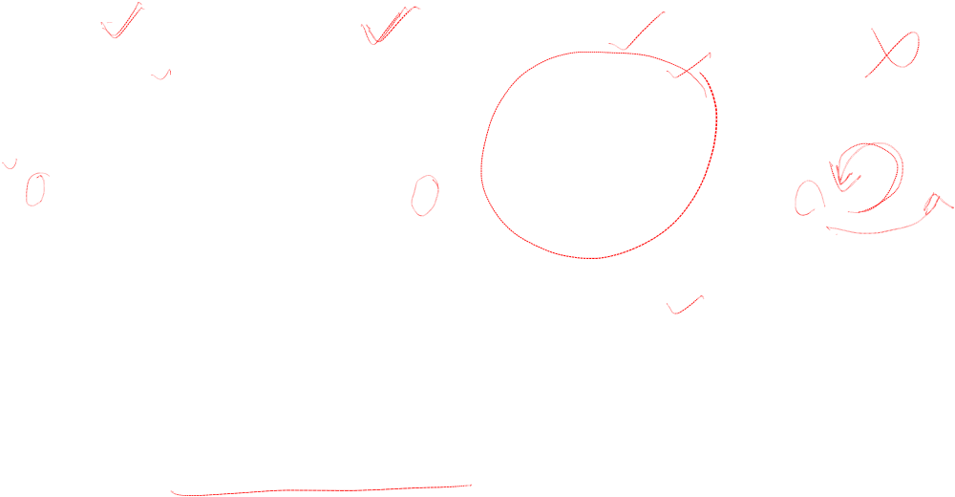
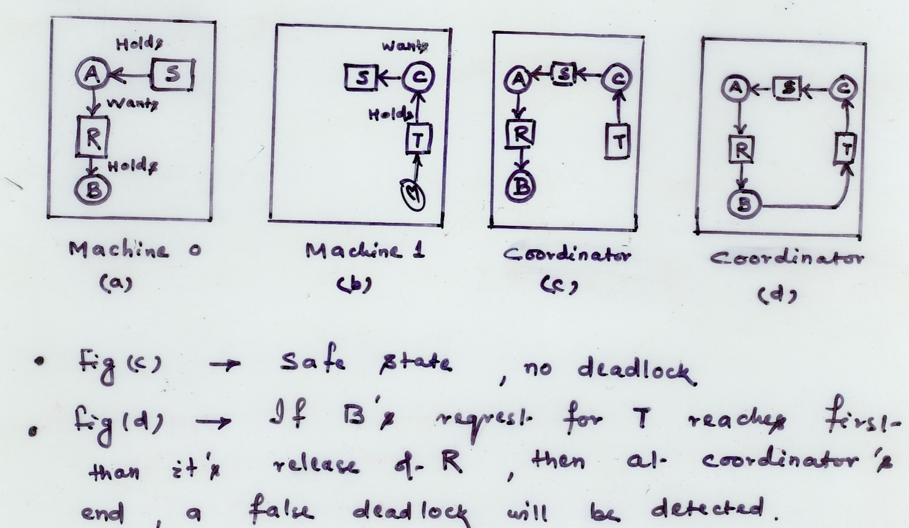
False deadlocks
Birla Institute of Technology and Science, Pilani (Deemed University)

Slide 8
Next session
Chandy-Misra-Haas (CMH) algorithm for AND model (Edge Chasing)
Birla Institute of Technology and Science, Pilani (Deemed University)

